Slide 1


Slide 2
Group Members
Annas Israr
Yaldram Shahzad
Faizan Ahmad
Zain Ul Abedin

Slide 3
Personalized News Information Retrieval (Web Application)
All Your Desired Information in One Click

Slide 4
Introduction
System will be used to help and facilitate the researchers
System will save the time of researchers (journalists) extracting relevant information from bulk amount of data available online.
Extract data from e newspapers, articles, journals and websites by using data and resources extraction technique.

Slide 5
Existing systems
Jung E-Paper
CNN.com

Slide 6
Daily jung E paper
Features
It allows daily updates of newspapers.
It allows the user to read news according to the city.
It provides a search facility which allows the user to search the required news.
It translates the query written in English into Urdu automatically.
Limitations
It’s only available in Urdu.
Newspaper is only available in pictorial form.
It only provides the links according to the searched query.

Slide 7

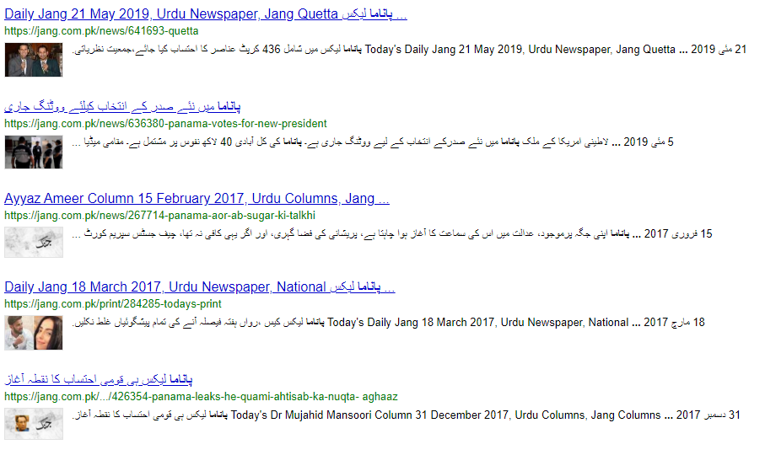
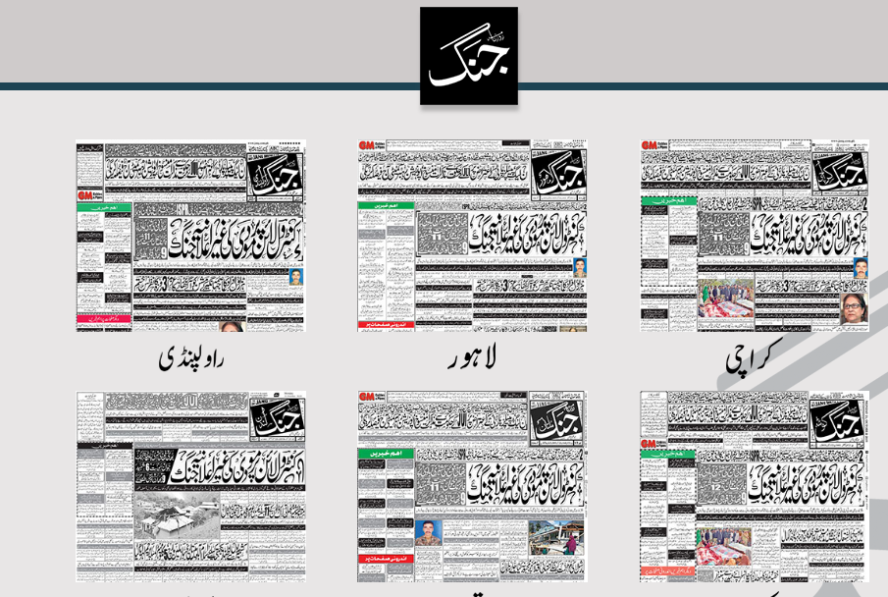

Slide 8
CNN.com
Features
Daily updates.
It provides different filters for the user to look up to information.
It provides a search facility to the user.
It categorizes the articles when the user searches something.
Limitations
It does not have any E newspapers only contains articles and blogs.
It provides a wide list of articles that may be impossible for the user to read.

Slide 9
Proposed system (1)
The proposed system will provide a new visitor with the top trending news about sports, politics and entertainment.
The proposed system will enable the user to register on this application and will save user’s preferences according to choices made at the time of registration.
The proposed system will provide a functionality to the user to look up news on their interests.
The proposed system will display any past events of user’s interests on that particular date.
The proposed system will allow the user to search news content related to politics, entertainment and sports.
The proposed system will search and provide summarized and relevant content according to users query.

Slide 10
Proposed system (2)
The proposed system will provide news from events of approximately past 15 years.
The proposed system will provide an option to import the compiled information on users system in the form of a document.
The proposed system is not only limited to textual data on websites but it can also analyze articles and pictorial information.
The proposed system will generate a document or report of the collected data along with references.
The proposed system will try to maintain balance about different perspectives about a same news and would not be biased.

Slide 11
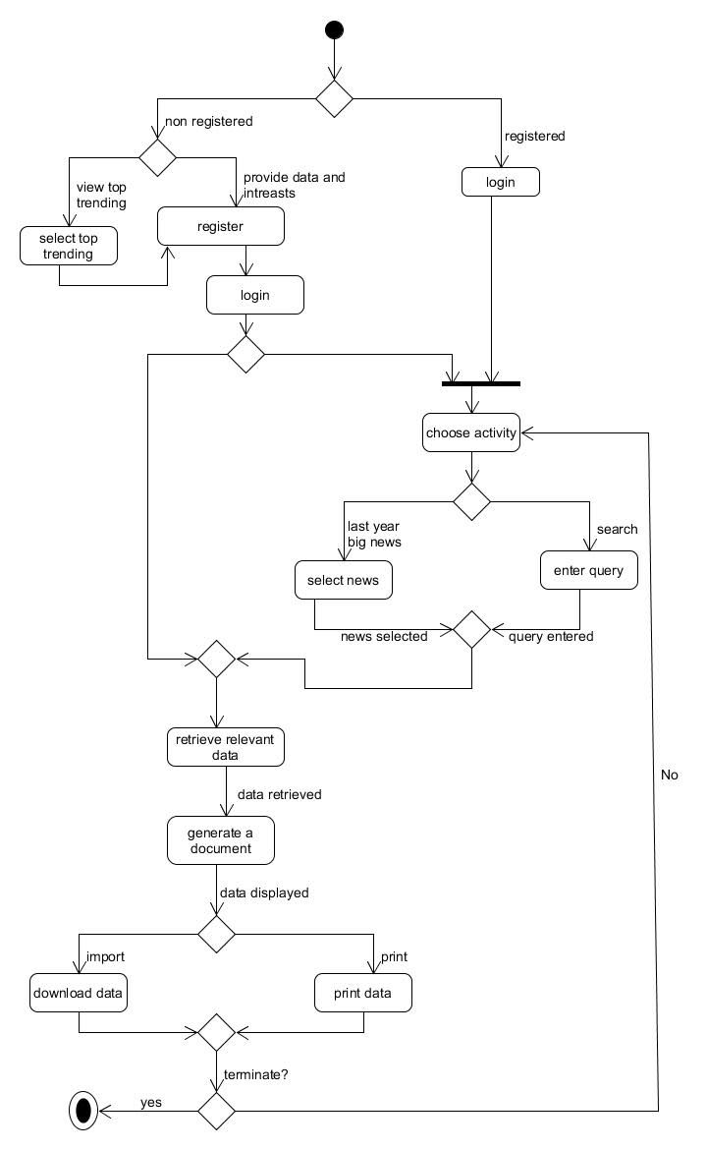
Flowchart of proposed system

Slide 12
Aims and objectives
This web application aims to help researchers to find relevant and accurate data with minimum effort
This web application aims to provide the data demanded by user without any hard searches.
This web application aim to provide best,qualitive, specific and relevant information from bulk amount of data available online
This web application aims to provide a base for a nonprofessional to know each and everything that can help him/her to overcome their problems.

Slide 13
SCOPE
This project will work on systematic browsing of news on internet based on related input scripts and will retrieve the information in a most relative and accurate way.
This project will help journalists, students and public to extract the news from available online data to minimize their time and effort and provide the required desired information.
The project will also generate a document or report of the collected data along with references.
The main thing about the project is to organize the non-tabular data to usable and structural format and save it permanently in the user’s local device.

Slide 14
Functional Requirements
User Registration
User Dashboard
Analyze Users Script
Scrapping of pages
Past News
Extraction of Text from HTML Pages
Extraction of content from Pictures
Extraction of text from tables
Saving Data on User’s System

Slide 15
Non-Functional requirements
Security
Reliability
Availability
Maintainability
Portability

Slide 16


